Slide 1
TUTORIAL 9
WORKING WITH THE DOCUMENT OBJECT MODEL

Slide 2
OBJECTIVES
Learn about document object models
Create and load a document object
Apply an XSLT transformation to a document
Use JavaScript to modify the contents of an XML document

Slide 3
OBJECTIVES
Use a form to e-mail the contents of an XML document
Use JavaScript to modify the attribute values of a document element
Use JavaScript to pass a value to a style sheet parameter

Slide 4
INTRODUCING THE DOCUMENT OBJECT MODEL
DOM:
  Stands for Document Object Model
  Developed by W3C
  Designed for XML and HTML
  Interface between programming language and document content

Slide 5
DOM LEVELS
Level 0:
  Compatible with older browsers
  HTML only
  Also known as basic model
Level 1:
  HTML and XML

Slide 6
DOM LEVELS
Level 2:
  Supports namespaces, Cascading Style Sheets, and user-initiated actions, such as mouse clicks and key strokes
Level 3:
  Support for document loading and saving
  Still under development

Slide 7
BROWSER SUPPORT
DOM is a specification only
Browser support for DOM varies
Internet Explorer
  Uses MSXML parser
  Parser must be downloaded separately
  MSXML 4.0 supports DOM Level 2

Slide 8
BROWSER SUPPORT
Netscape Navigator
  Uses Xpat parser
  Parser is built-in
  Netscape 6.0 supports DOM Level 2

Slide 9
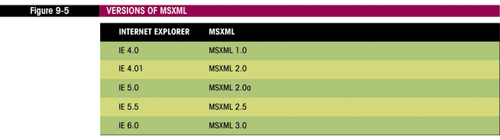
MSXML VERSIONS

Slide 10
SIMPLE API FOR XML (SAX)
Alternative to DOM
Less memory intensive
Browser support is limited
MSXML 4.0 supports SAX

Slide 11
CREATING A DOCUMENT OBJECT
No specifications in DOM on document loading
Different browsers use different techniques
Tutorial covers Internet Explorer only
JavaScript variables hold reference to document

Slide 12
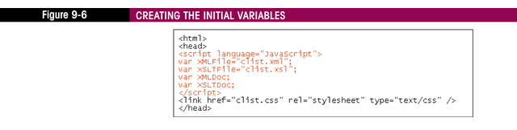
CREATING VARIABLES

Slide 13
CREATING DOCUMENT OBJECTS
Syntax: var DOMDocument = new ActiveXObject(“progID”)
  DOMDocument is document variable name
  progID depends on document and version of MSXML
Sample: var XMLDoc=new ActiveXObject(“MSXML2.DOMDocument”);

Slide 14
PROGID
Values for XML documents:
  MSXML4.DOMDocument
  MSXML3.DOMDocument
  MSXML2.DOMDocument
  MSXML.DOMDocument
  Microsoft.XmlDom
Rental-thread model
  Designed for single-threaded access
  Preferable for XML documents
  Uses memory efficiently

Slide 15
PROGID
Values for XSL documents:
  MSXML4.FreeThreadedDOMDocument
  MSXML3.FreeThreadedDOMDocument
  MSXML2.FreeThreadedDOMDocument
  MSXML.FreeThreadedDOMDocument
Free-threaded model:
  Processor accesses document with multiple threads
  Suitable for XSL documents

Slide 16
CREATING DOCUMENT OBJECTS
No way to tell in advance version of MSXML on user’s machine
Try to create with highest parser version
If error occurs, try next-highest level
Use JavaScript array and loop to create document

Slide 17
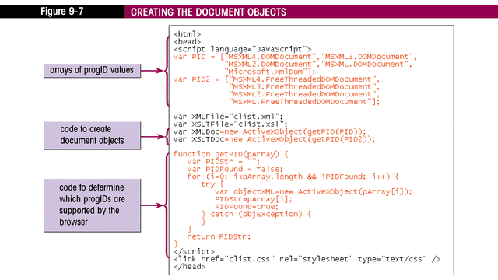
CREATING DOCUMENT OBJECTS (CODE)

Slide 18
LOADING A FILE INTO A DOCUMENT OBJECT
Asynchronous load:
  Application does not wait for the file to load before proceeding to the line in the program
  Default
Synchronous load:
  Causes the application to stop until the file is completely loaded
  Preferred method
Syntax: DOMDocument.async=false

Slide 19
LOADING A FILE INTO A DOCUMENT OBJECT
Syntax: DOMDocument.load(url)
  url is location and filename of file to load
  Microsoft extension to DOM
Syntax: DOMDocument.loadXML(xmlString)
  Loads XML contained in a string into document
  Microsoft extension

Slide 20
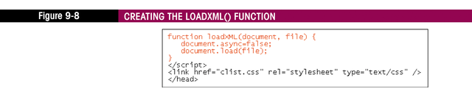
CREATING A LOADXML FUNCTION

Slide 21
TRANSFORMING A DOCUMENT
Syntax: Node.transformNode(style)
  Node is a document or node within a document
  Style is a XSLT stylesheet
  Returns a text string
  Result can be written to browser using document.write
Syntax: Node.transformNodeToObject(style,output)
  Output is an object that receives result of transform

Slide 22
CREATING A TEMPLATE OBJECT
Transform methods consume system resources
Template object stores compiled stylesheet
Syntax to create: var TemplateObject = new ActiveXObject(“progID”)
  ProgID values:
    MSXML4.XSLTemplate
    MSXML3.XSLTemplate
    MSXML2.XSLTemplate
    MSXML.XSLTemplate

Slide 23
CREATING A TEMPLATE OBJECT
Store the stylesheet in the template
Syntax: TemplateObject.stylesheet=XSLTDocument;

Slide 24
CREATING A PROCESSOR
Processor object runs transformation
Use template to create processor
Syntax: XMLProcessor=XSLTemp.createProcessor();
To transform:
  Specify the input or source document
  Run the transform() method
  Specify the output or result document

Slide 25
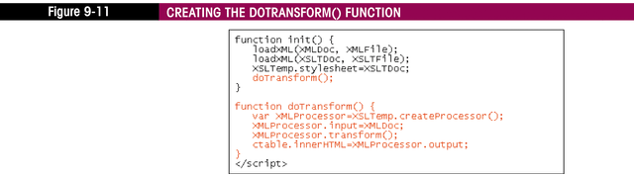
CREATING THE DOTRANSFORM FUNCTION

Slide 26
WORKING WITH THE DOCUMENT OBJECT
Document content is stored in nodes
Nodes can represent any item (element, attribute, etc.)
Nodes are organized in a node tree

Slide 27
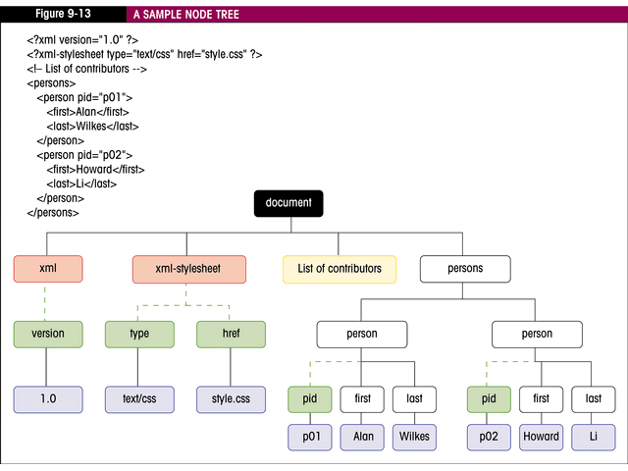
SAMPLE NODE TREE

Slide 28
NODE TERMONOLOGY
Parent node:
  Contains other nodes
Child node:
  Contained by a parent
Sibling nodes:
  Share same parent
Attribute nodes:
  Do not have parents

Slide 29
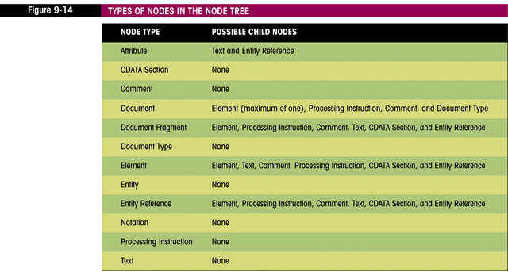
NODE TYPES

Slide 30
THE ROOT ELEMENT
To reference root element:
  Syntax: DOMDocument.documentElement
  Sample: XMLDoc.documentElement

Slide 31
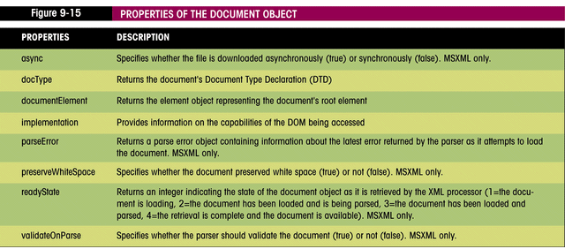
PROPERTIES OF THE DOCUMENT OBJECT

Slide 32
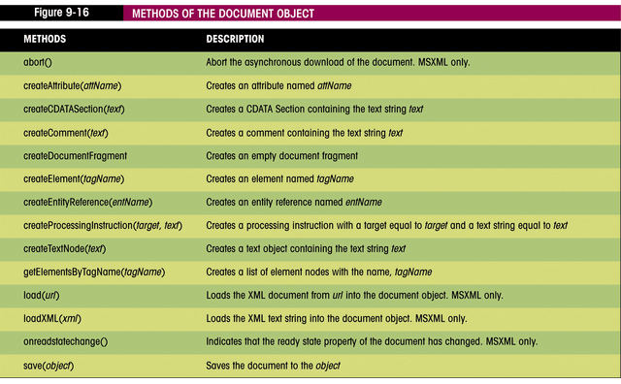
METHODS OF THE DOCUMENT OBJECT

Slide 33
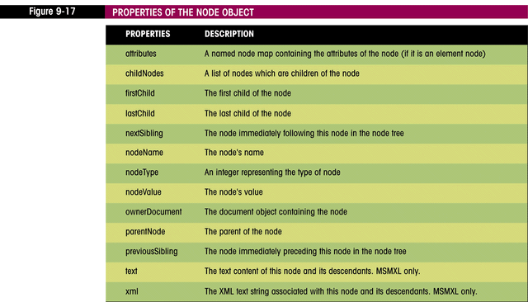
WORKING WITH NODE OBJECTS

Slide 34
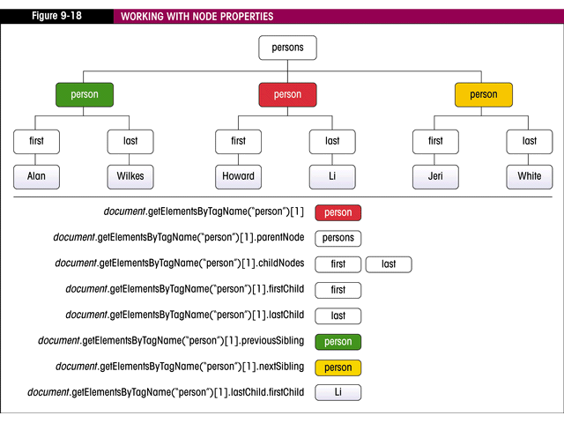
WORKING WITH NODE PROPERTIES

Slide 35
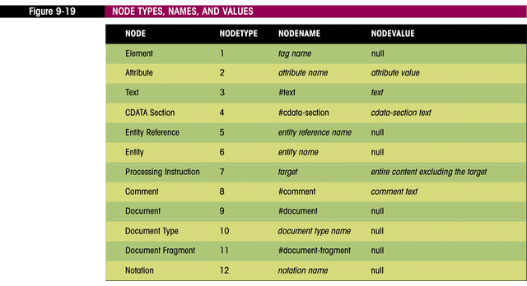
NODE TYPES, NAMES, AND VALUES

Slide 36
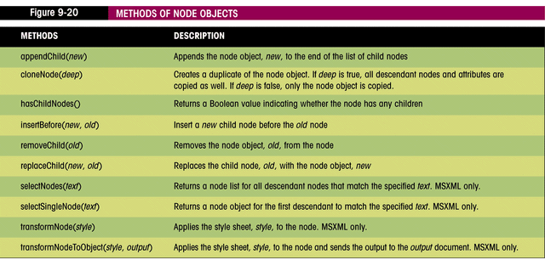
METHODS OF NODE OBJECTS

Slide 37
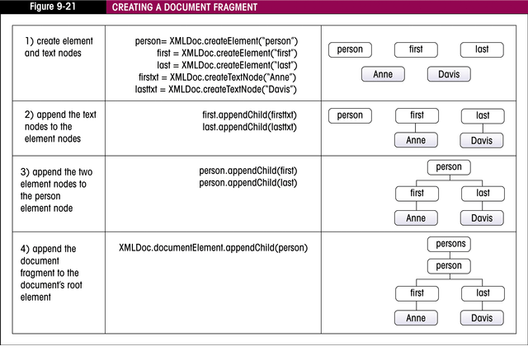
CREATING A DOCUMENT FRAGMENT

Slide 38
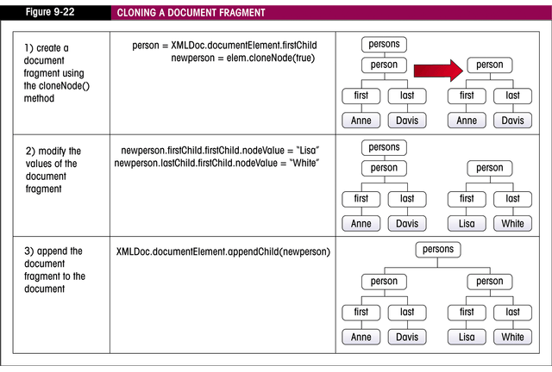
CLONING A DOCUMENT FRAGMENT

Slide 39
ADDING NEW RECORDS
Clone an existing record
Set property values by setting nodeValue for firstChild of each element
Syntax: clone.childNodes[i].firstChild.nodeValue=text
To reference form fields:
  document.form.field.value
To add new node use appendChild()

Slide 40
SAVING AN XML DOCUMENT
Changes made to a document are stored in memory
No method in JavaScript to write a file
  For security reasons
No method in DOM to save an XML file

Slide 41
MSXML SAVE METHOD
Syntax: DOMDocument.save(type)
  Type is one of:
    A filename
    The name of another document object
    An ASP (Active Server Page) response object
    A custom COM object that supports persistence
Can only be used on a Web server

Slide 42
XML PROPERTY
Syntax: object.xml
  Object is document or node
Returns content of object as text string
Can be written to hidden form field then submitted to cgi or e-mailed

Slide 43
XMLHTTP Object
Uses HTTP protocol to pass documents to programs running on a server
To use:
  XMLHTTP Object is created
  Connection to server is opened
  Document is send
  Response is received

Slide 44
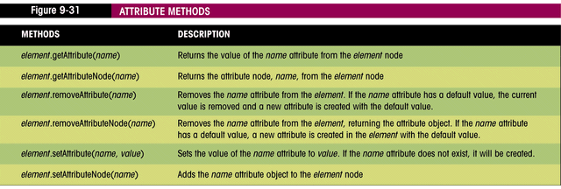
WORKING WITH ATTRIBUTES

Slide 45
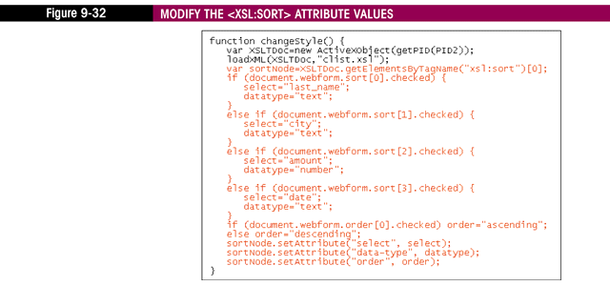
MODIFYING ATTRIBUTE VALUES

Slide 46
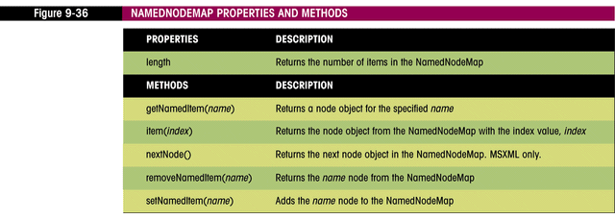
WORKING WITH NAMED NODE MAPS
Collection of nodes
Allows programmers to access nodes by name as well as index

Slide 47
USING PARAMETERS
MSXML method of setting parameters:
  Syntax: ProcessorObject.addParameter(parameter, value, namespaceURI)
Must convert value to a node not a string using selectNodes method:
  Syntax: node.selectNodes(expression)

Slide 48
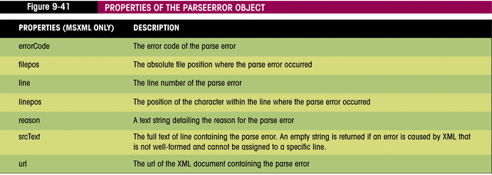
DEBUGGING TECHNIQUES
MSXML does not automatically report errors
Errors are saved in parseError object

Slide 49
SUMMARY
DOM specification is used to work with HTML and XML documents
Components of document (elements, attributes, etc.) are nodes
Element and attribute values can be modified
No DOM specification for loading or saving documents
Error information is saved in parseError object

